Slide 1
A Tour of OpenGL

Slide 2
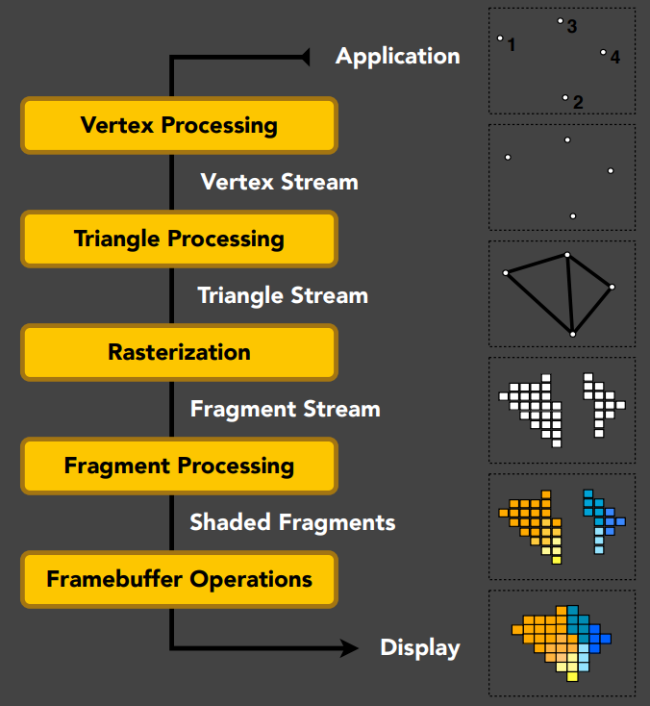
OpenGL
Is a set of APIs that call the GPU pipeline from CPU
User
Mode
Vertex Processing
App A
App B
OpenGL API
Primitive Assembly
Rasterization
OpenGL UMD
(ICD)
Fragment Processing
Kernel Mode
DXG Kernel
Framebuffer Operation
KMD DDI
KMD
GPU
Graphic Pipeline
OpenGL on Windows Vista

Slide 3
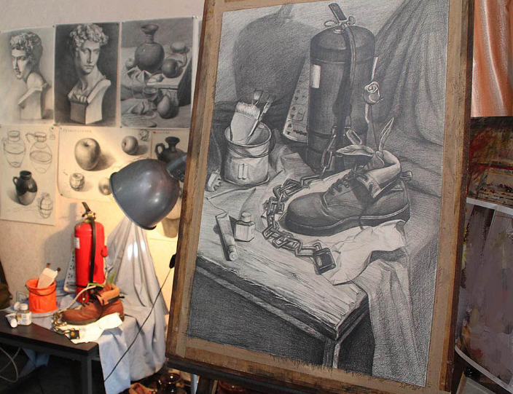
In Analogy to Painting
Place models
Model specification
Model transformation
Setup an easel
View transformation
To hold a canvas
Attach a canvas to the easel
For the brush to paint on
Paint to the canvas
Use different painting technics

Slide 4
In Terms of OpenGL
Place models
Transfer model data to GPU
Setup an easel
Setup a framebuffer
Attach a canvas to the easel
Textures as attachments
Paint to the canvas
Use a shader program
Invoke a draw call

Slide 5
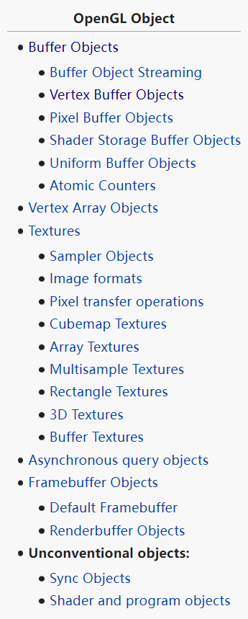
OpenGL Objects
Place objects
Vertex Array Object
Vertex / Index Buffer Object
Set position of an easel
Framebuffer Object
Attach a canvas to the easel
Texture Object
Paint to the canvas
Attach a shader
Transfer uniform variables to shader
Invoke a draw call

Slide 6
Objects Data in OpenGL
Vertex Array Object
Vertex usage specification
Attribute pointer
VAO
attribute pointer 0
attribute pointer 1
attribute pointer 2
…
Vertex Buffer Object
Position
Normal
Texture Coordinate
index buffer object
VBO 1
pos[0]
nrm[0]
pos[1]
nrm[1]
…
pos[n]
VBO 2
Index Buffer Object
Indices of vertex
uv[0]
uv[1]
uv[2]
uv[3]
…
uv[n]
IBO
2
3
5
3
5
4
7
1
2
…

Slide 7
Render in OpenGL
Vertex Processing
GLSL Program
Various shader types
Vertex shader
Fragment shader
Transfer data to GPU
Buffer objects
Uniform variables
Textures
Vertex Shader
Primitive Assembly
Rasterization
Fragment Shader
Draw Call
glDrawArrays(Instanced)
glDrawElements(Instanced)
glDraw*Indirect
glMultiDraw*Indirect
Framebuffer Operation

Slide 8
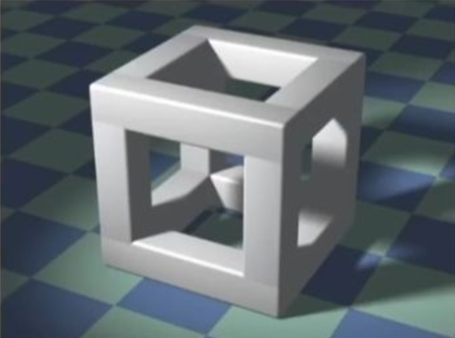
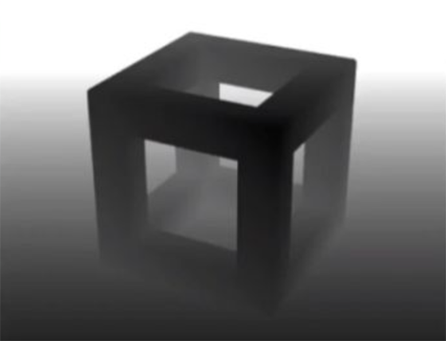
Output of OpenGL
Framebuffer Object
Color attachment
Depth attachment
Stencil attachment
Screen Display
Write the result to a texture
Submit the texture to OS
Compositor compose textures
Write the result to the framebuffer
Mapping framebuffer to screen
Framebuffer object != Framebuffer

Slide 9
A Naïve OpenGL Program
Setup Process
Setup a window (setup a framebuffer consequently)
Setup VAO / VBO / IBO for models
Setup textures
Setup shaders
Handle Input
Response to mouse/keyboard input
Update the corresponding data structure
Render Process
Use a framebuffer
For each render pass
Use a shader
Enable a VAO
Invoke a draw call

Slide 10


References
Games 202
GAMES202-高质量实时渲染
上帝视角看GPU
上帝视角看GPU（1）：图形流水线基础
上帝视角看GPU（4）：完整的软件栈
Learning OpenGL
LearnOpenGL CN (learnopengl-cn.github.io)

Slide 11
Thank you!

